Slide 1
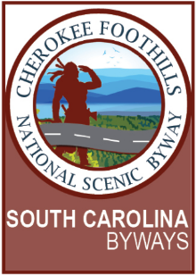
Final Report Summary
Pickens County Planning Commission
April 18, 2022

Slide 2
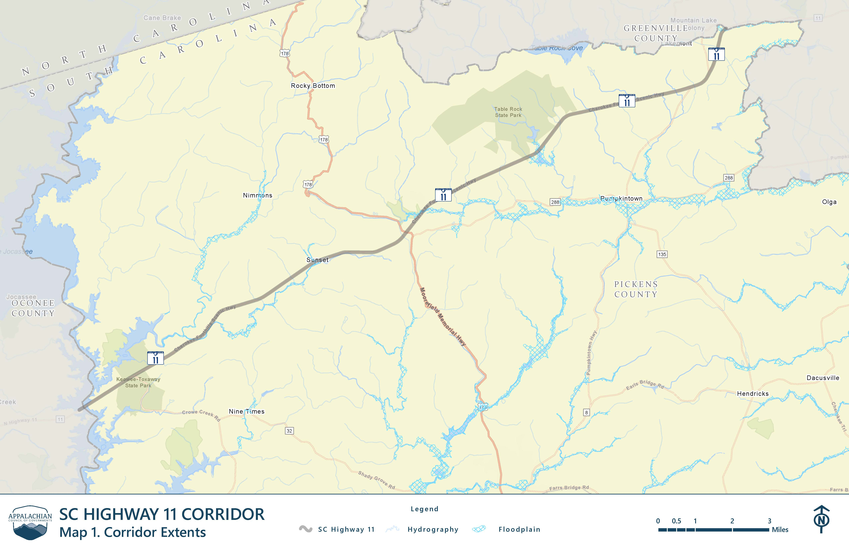

Slide 3
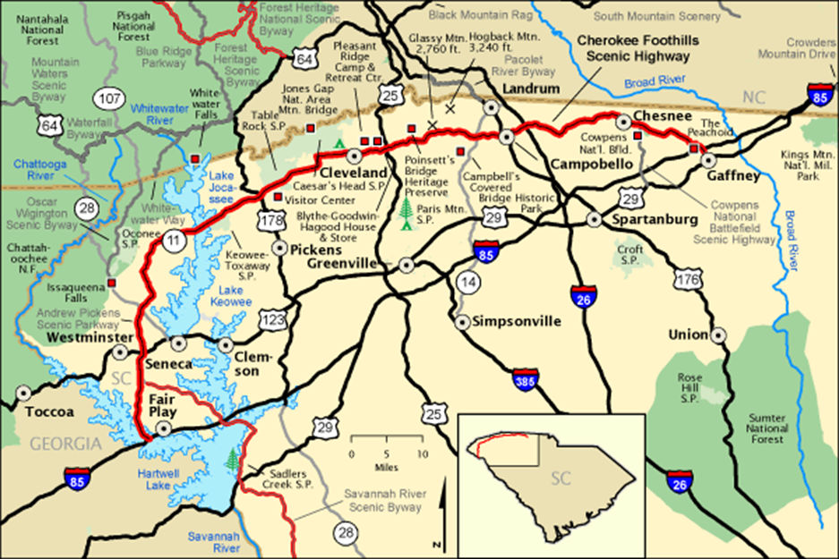
Purpose of the Study
Review existing conditions along Highway 11 (slopes, traffic, crashes, topography, etc.)
Solicit public opinion about the future of the corridor (public meetings, survey, focus groups)
Provide recommendations to the County on how to address future development

Slide 4
Project Timeline
2021
2022
SEP OCT NOV DEC JAN FEB MAR APR MAY
Focus Groups
October 26, 2021
Progress Report
January 2022
Public Meeting #3
March 2022
Final Plan
April 11, 2022
PROJECT INITATION
PRELIMINARY REVIEW AND ANALYSIS
ISSUES, GOALS, POLICIES, AND RECOMMENDATIONS
FINAL PLAN AND ADOPTION
Public Meeting #1
October 19, 2021
One on One Meetings
with Stakeholders
December 9, 2021
Kick Off Meeting with Pickens County staff
September 2021
Public Meeting #2
March 2022
Planning Commission Public Hearing
April 18, 2022

Slide 5
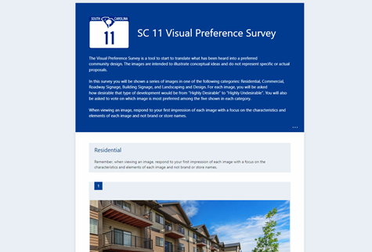
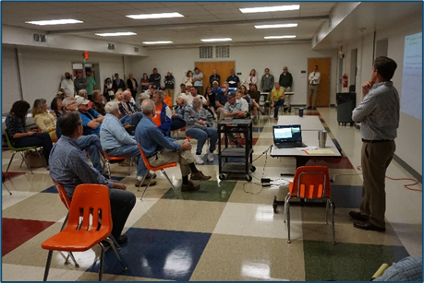
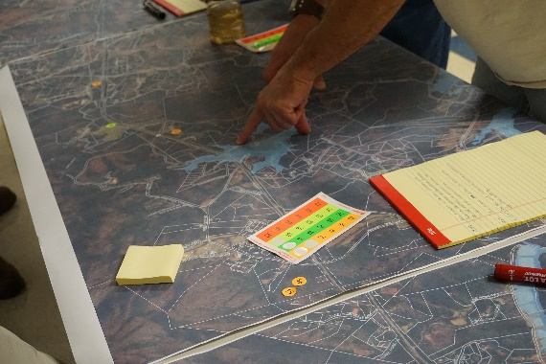
Public Involvement
3 Community Meetings
October 19, 2021 (70 attendees)
March 10, 2022 (25 attendees)
March 31, 2022 (150 attendees)
Visual Preference Survey
283 responses as of April 18, 2022
Focus Group Meetings
October 26, 2021 (15 participants)
Local Business Owners and Parks/Conservation Representatives

Slide 6
Common Themes
Maintain Character of Highway 11
Protect scenic views, limit intensive uses, buffer development from highway
Minimum Standards for New Development
Provide for a cohesive aesthetic, ensure new development blends in
Establishing Corridor Boundaries and Viewsheds Beyond
Protect viewsheds and distant vistas outside of the corridor boundary, prevent clear cutting
Improve Traffic and Safety
Improve intersections with high crashes, enforce speed limit, reduce truck traffic

Slide 8
Planning Tools
Design Guidelines
Addresses aesthetic of development (materials, roof design, signage, landscaping, lighting, parking), does not address use
Zoning
Control use and site design (landscaping, parking, setbacks, etc.), does not control design on its own – would need separate Overlay District for design controls
Conservation Subdivisions
Clusters homes into a small portion of the property, reserves the remainder as open space

Slide 9
Planning Tools
Low Impact Development
Requires each site to design according to topography, tree canopy, etc. and manages stormwater run-off
Tax Abatements and Exemptions
Provides tax incentives for a desired type of development
Conservation Easements
Protects significant natural, cultural, and/or historic resources through easements that restrict certain types of development

Slide 10
Recommendations
Highway 11 Corridor Design Guidelines
Use same boundary as moratorium (660 feet from centerline)
Architectural design guidelines should address the following elements at a minimum: building materials, colors, roof design, windows, entrances, special architectural features, and signage.
Site design guidelines should address the following elements at a minimum: parking, landscaping, exterior lighting, screening and buffering, and driveway/access locations.
Considerations
Setback and ROW buffering from Highway 11
Slope Analysis

Slide 11
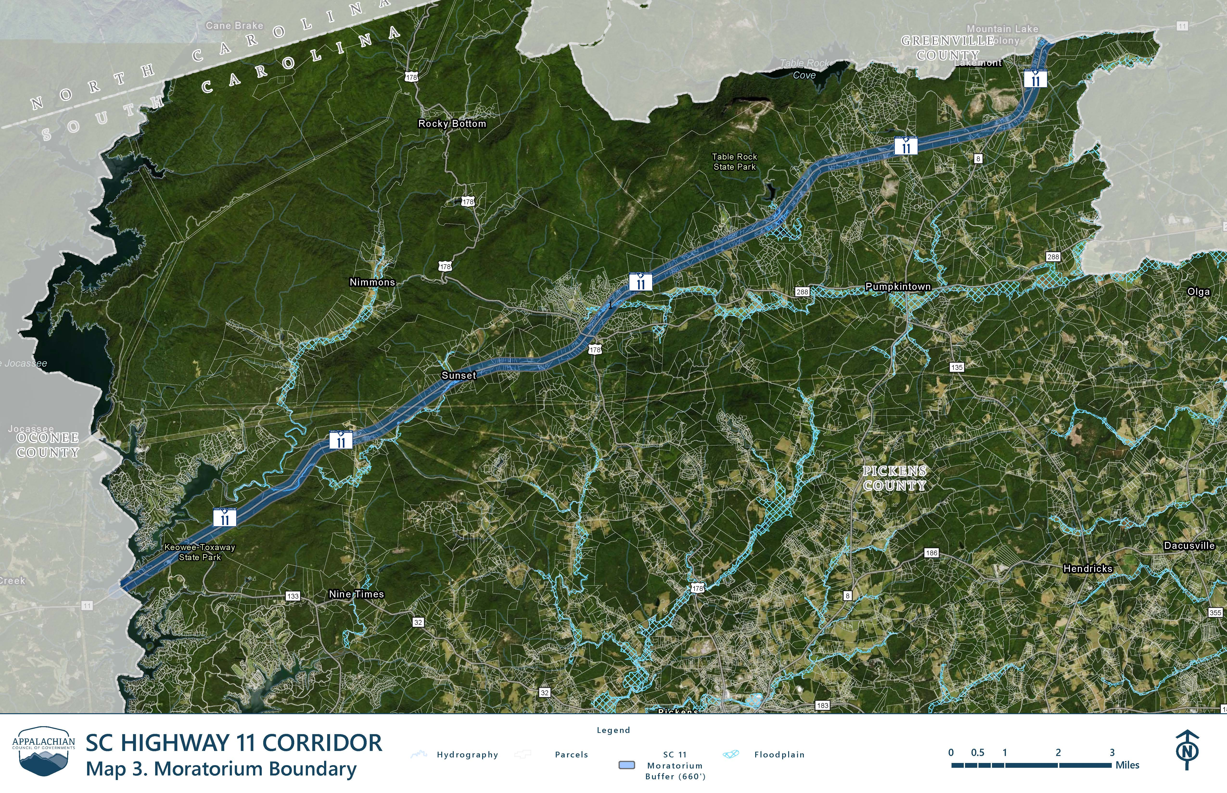

Slide 12
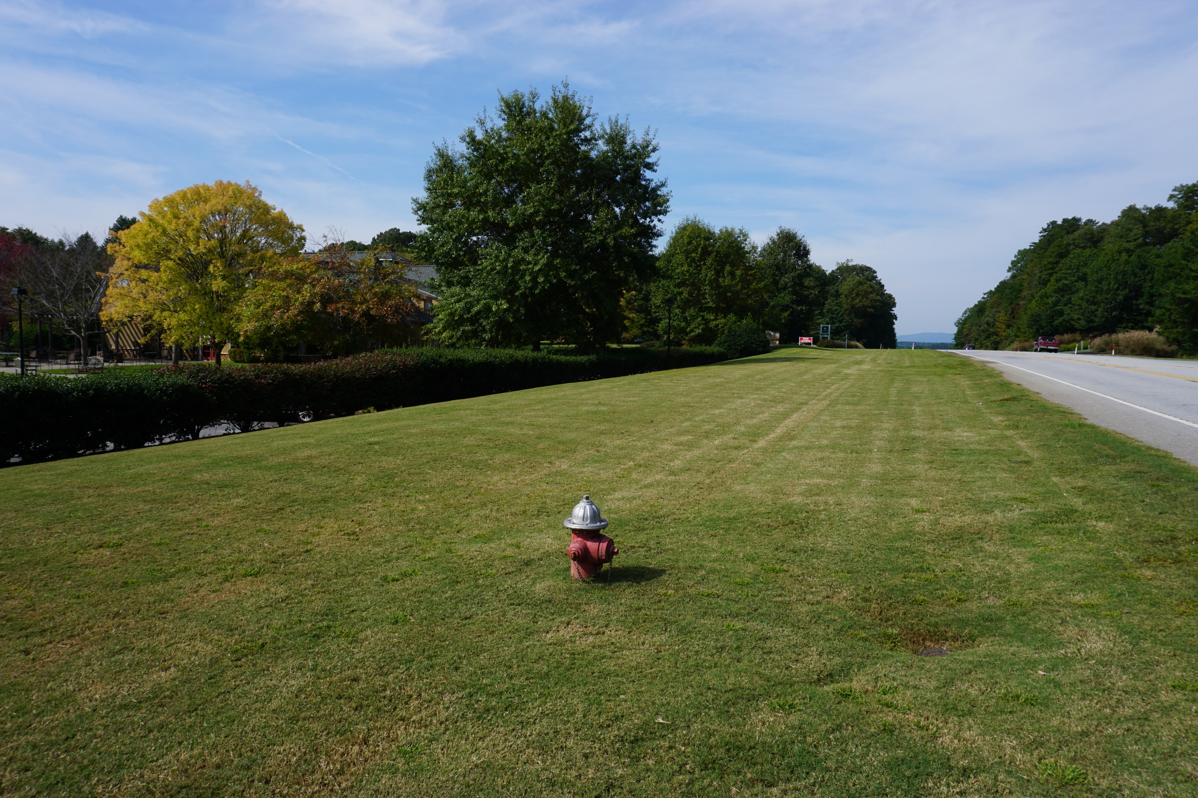
60-foot ROW buffer from pavement edge

Slide 13
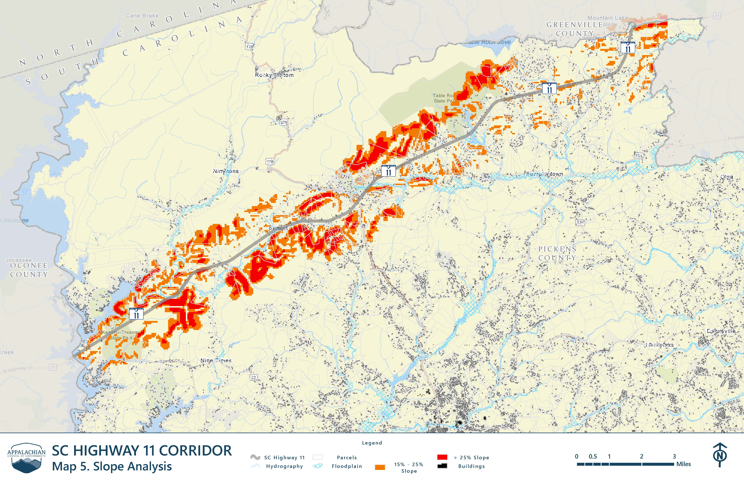

Slide 14
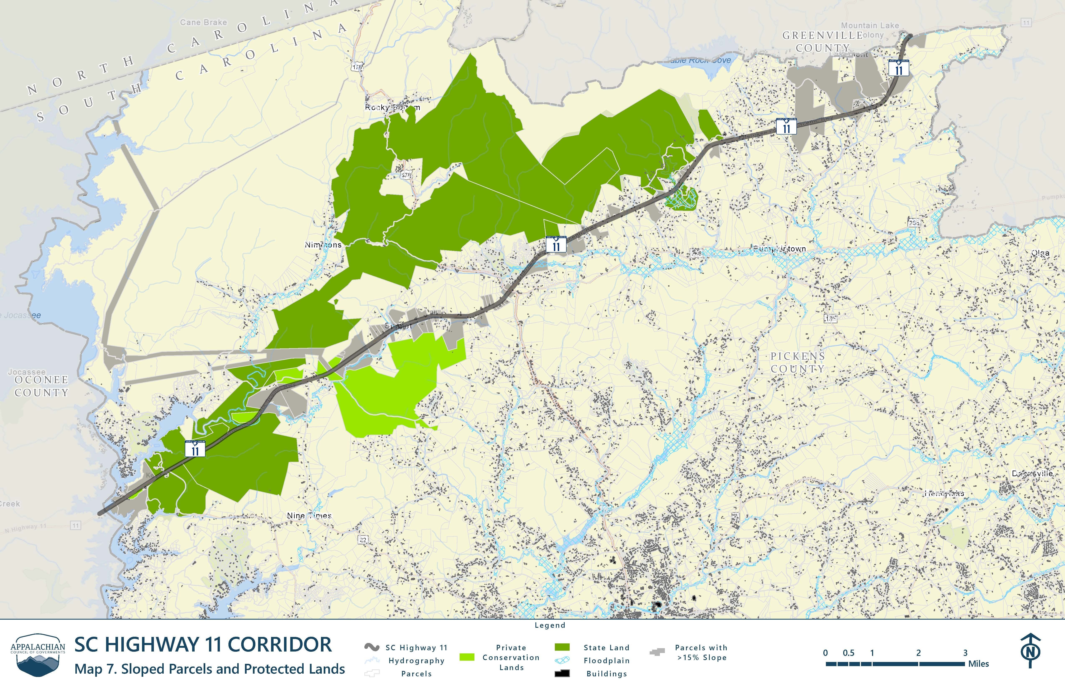

Slide 15
Recommendations
Amendments to Unified Development Standards Ordinance
Incorporate moderate and steep slope development standards
Add language to minimize / restrict cut and fill development
Viewshed Study of the Corridor
Look beyond Highway 11 corridor boundary
Protect views of lakes, greenbelts, mountains, etc.
Develop a Conservation Strategy
Other counties taking proactive approach through conservation trusts
Can be used as tool to protect viewsheds outside of the Highway 11 corridor

Slide 16
Any Questions?

